Slide 1
Information Extraction

Slide 2
Two Types of Extraction
Extracting from template-based data
An example on how this data is generated
Querying on Amazon by filling in a form interface using Jignesh Patel
The query goes to a database in the backend
Database result is plugged into template-based pages
This is called wrappers
Extracting entities and relationships from textual data

Slide 3
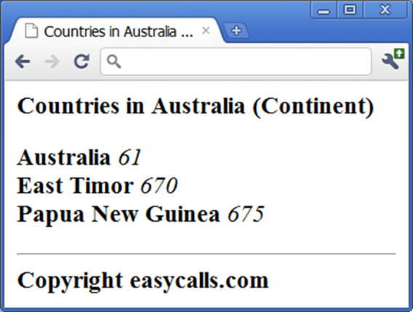
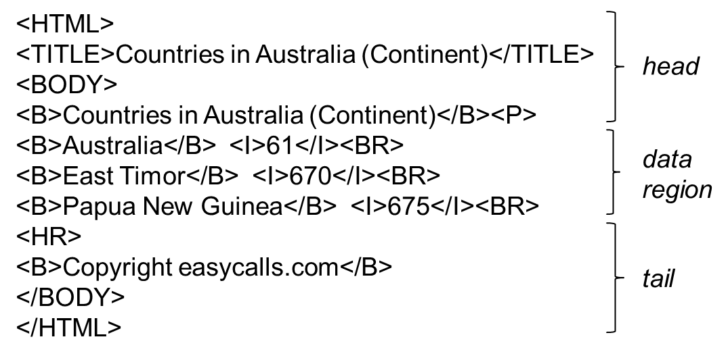
Wrappers

Slide 4
IE from Text
Attribute | Walmart Product | Vendor Product
Product Name | CHAMP Bluetooth Survival Solar Multi-Function Skybox with Emergency AM/FM NOAA Weather Radio (RCEP600WR) | CHAMP Bluetooth Survival Solar Multi-Function Skybox with Emergency AM/FM NOAA Weather Radio (RCEP600WR)
Product Short Description | BLTH SURVIVAL SKYBOX W WR
Product Long Description | BLTH SURVIVAL SKYBOX W WR | BLTH SURVIVAL SKYBOX W WR
Product Segment | Electronics | Electronics
Product Type | CB Radios & Scanners | Portable Radios
Color | Black
Actual Color | Black
UPC |  | 0004447611732
Unique product identifier (aka key in e-commerce industry)

Slide 5
IE from Text
Attribute | Walmart Product | Vendor Product
Product Name | GreatShield 6FT Apple MFi Licensed Lightning Sync Charge Cable for Apple iPhone 6 6 Plus 5S 5C 5 iPad 4 Air Mini - Black | GreatShield 6FT Apple MFi Licensed Lightning Sync Charge Cable for Apple iPhone 6 6 Plus 5S 5C 5 iPad 4 Air Mini - White
Product Short Description | GreatShield 6FT Apple MFi Licensed Lightning Sync Charge Cable for Apple iPhone 6 6 Plus 5S 5C 5 iPad 4 Air Mini - Black
Product Long Description | GreatShield Apple MFi Licensed Lightning Charge & Sync Cable This USB 2.0 cable connects your iPhone, iPad, or iPod with Lightning … | GreatShield Apple MFi Licensed Lightning Charge & Sync Cable This USB 2.0 cable connects your iPhone, iPad, or iPod with Lightning …
Product Segment | Electronics | Electronics
Product Type | Cable Connectors | Cable Connectors
Brand | GreatShield | GreatShield
Manufacturer Part Number | GS09055

Slide 6
IE from Text
For years, Microsoft Corporation CEO Bill Gates was against open source. But today he appears to have changed his mind. "We can be open source. We love the concept of shared source," said Bill Veghte, a Microsoft VP. "That's a super-important shift for us in terms of code access.“
Richard Stallman, founder of the Free Software Foundation, countered saying…
Select Name
From PEOPLE
Where Organization = ‘Microsoft’
PEOPLE
Name Title Organization
Bill Gates CEO Microsoft
Bill Veghte VP Microsoft
Richard Stallman Founder Free Soft..
Bill Gates
Bill Veghte
(from Cohen’s IE tutorial, 2003)

Slide 7
Two Main Solution Approaches
Hand-crafted rules
Eg regexes
Dictionary based
Learning-based approaches

Slide 8
Example: Regexes
Extract attribute values from products
title = X-Mark Pair of 45 lb. Rubber Hex Dumbbells
material = Rubber
finer categorizations = Dumbbells__Weight Sets
type = Hand Weights
…
title = Zalman ZM-T2 ATX Mini Tower Case - Black
brand = Zalman
finer categorizations = Computer Cases
…

Slide 9
Example
Discuss how to extract weights such as 45 lbs
Something to recognize the number
Something to recognize all variations of weight units
The resulting regex can be very complicated

Slide 10
Example: Dictionary Based
Goal: build a simple person-name extractor
input: a set of Web pages W, a list of names
output: all mentions of names in W
Simplified Person-Name extraction
for each name e.g., David Smith
generate variants (V): “David Smith”, “D. Smith”, “Smith, D.”, etc.
find occurrences of these variants in W
clean the occurrences

Slide 11
Compiled Dictionary
…….
…….
…….
…….
…….
…….
…….
David Miller
Rob Smith
Renee Miller
D. Miller, R. Smith, K. Richard, D. Li

Slide 12
Hand-coded rules can be arbitrarily complex
Find conference name in raw text
############################################################################# # Regular expressions to construct the pattern to extract conference names ############################################################################# # These are subordinate patterns my $wordOrdinals="(?:first|second|third|fourth|fifth|sixth|seventh|eighth|ninth|tenth|eleventh|twelfth|thirteenth|fourteenth|fifteenth)"; my $numberOrdinals="(?:\\d?(?:1st|2nd|3rd|1th|2th|3th|4th|5th|6th|7th|8th|9th|0th))"; my $ordinals="(?:$wordOrdinals|$numberOrdinals)"; my $confTypes="(?:Conference|Workshop|Symposium)"; my $words="(?:[A-Z]\\w+\\s*)"; # A word starting with a capital letter and ending with 0 or more spaces my $confDescriptors="(?:international\\s+|[A-Z]+\\s+)"; # .e.g "International Conference ...' or the conference name for workshops (e.g. "VLDB Workshop ...") my $connectors="(?:on|of)"; my $abbreviations="(?:\\([A-Z]\\w\\w+[\\W\\s]*?(?:\\d\\d+)?\\))"; # Conference abbreviations like "(SIGMOD'06)" # The actual pattern we search for. A typical conference name this pattern will find is # "3rd International Conference on Blah Blah Blah (ICBBB-05)" my $fullNamePattern="((?:$ordinals\\s+$words*|$confDescriptors)?$confTypes(?:\\s+$connectors\\s+.*?|\\s+)?$abbreviations?)(?:\\n|\\r|\\.|<)"; ############################## ################################ # Given a <dbworldMessage>, look for the conference pattern ############################################################## lookForPattern($dbworldMessage, $fullNamePattern); ######################################################### # In a given <file>, look for occurrences of <pattern> # <pattern> is a regular expression ######################################################### sub lookForPattern { my ($file,$pattern) = @_;

Slide 13
Example Code of Hand-Coded Extractor
# Only look for conference names in the top 20 lines of the file my $maxLines=20; my $topOfFile=getTopOfFile($file,$maxLines); # Look for the match in the top 20 lines - case insenstive, allow matches spanning multiple lines if($topOfFile=~/(.*?)$pattern/is) { my ($prefix,$name)=($1,$2); # If it matches, do a sanity check and clean up the match # Get the first letter # Verify that the first letter is a capital letter or number if(!($name=~/^\W*?[A-Z0-9]/)) { return (); } # If there is an abbreviation, cut off whatever comes after that if($name=~/^(.*?$abbreviations)/s) { $name=$1; } # If the name is too long, it probably isn't a conference if(scalar($name=~/[^\s]/g) > 100) { return (); } # Get the first letter of the last word (need to this after chopping off parts of it due to abbreviation my ($letter,$nonLetter)=("[A-Za-z]","[^A-Za-z]"); " $name"=~/$nonLetter($letter) $letter*$nonLetter*$/; # Need a space before $name to handle the first $nonLetter in the pattern if there is only one word in name my $lastLetter=$1; if(!($lastLetter=~/[A-Z]/)) { return (); } # Verify that the first letter of the last word is a capital letter # Passed test, return a new crutch return newCrutch(length($prefix),length($prefix)+length($name),$name,"Matched pattern in top $maxLines lines","conference name",getYear($name)); } return (); }

Slide 14
Two Main Solution Approaches
Hand-crafted rules
Eg regexes
Dictionary based
Learning-based approaches

Slide 15
IE from Text
For years, Microsoft Corporation CEO Bill Gates was against open source. But today he appears to have changed his mind. "We can be open source. We love the concept of shared source," said Bill Veghte, a Microsoft VP. "That's a super-important shift for us in terms of code access.“
Richard Stallman, founder of the Free Software Foundation, countered saying…
Select Name
From PEOPLE
Where Organization = ‘Microsoft’
PEOPLE
Name Title Organization
Bill Gates CEO Microsoft
Bill Veghte VP Microsoft
Richard Stallman Founder Free Soft..
Bill Gates
Bill Veghte
(from Cohen’s IE tutorial, 2003)

Slide 16
A Quick Intro to Classification
Also known as supervised learning
Given training examples, train a classifier
Apply the classifier to a new example to classify
Training examples: feature vectors + label
A new example: a feature vector
Example: predict if a guy will be a good husband

Slide 17
Learning to Extract Person Names
For years, Microsoft Corporation CEO Bill Gates was against open source. But today he appears to have changed his mind. "We can be open source. We love the concept of shared source," said Bill Veghte, a Microsoft VP. "That's a super-important shift for us in terms of code access.“
Richard Stallman, founder of the Free Software Foundation, countered saying…
Select Name
From PEOPLE
Where Organization = ‘Microsoft’
PEOPLE
Name Title Organization
Bill Gates CEO Microsoft
Bill Veghte VP Microsoft
Richard Stallman Founder Free Soft..
Bill Gates
Bill Veghte
(from Cohen’s IE tutorial, 2003)

Slide 18
The Entire End-to-End Process
Take some pages
Manually mark up all person names
Create a set of features
Convert each marked-up name into a feature vector with a positive label => a positive example
Create negative examples
Train a classifier on training data
Now use it to extract names from the rest of the pages
Must generate candidate names
Compute accuracy

Slide 19
Computing Accuracy, or How To Evaluate IE Solutions?
Precision
Recall
Precison/Recall curve
Often need to know what is the accuracy target of the end application.

Slide 20
In Practice the Whole Process is More Complex
Development stage
Develop best extractor, try to fine tune as much as possible
Production stage
Apply to (often a lot of) data

Slide 21
Hand-Coded Methods
Easy to construct in many cases
e.g., to recognize prices, phone numbers, zip codes, conference names, etc.
Easier to debug & maintain
especially if written in a “high-level” language (as is usually the case)
Eg this is zipcode because it’s five digits and is preceded by two capitalized characters
Easier to incorporate / reuse domain knowledge
Can be quite labor intensive to write

Slide 22
Learning-Based Methods
Can work well when training data is easy to construct and is plentiful
Can capture complex patterns that are hard to encode with hand-crafted rules
e.g., determine whether a review is positive or negative
extract long complex gene names
[From AliBaba]
The human T cell leukemia lymphotropic virus type 1 Tax protein represses MyoD-dependent transcription by inhibiting MyoD-binding to the KIX domain of p300.“
Can be labor intensive to construct training data
not sure how much training data is sufficient
Can be hard to understand and debug
Complementary to hand-coded methods

Slide 23
A New Solution Method: Crowdsourcing (Next Few Slides Taken From a KAIST Tutorial)

Slide 24
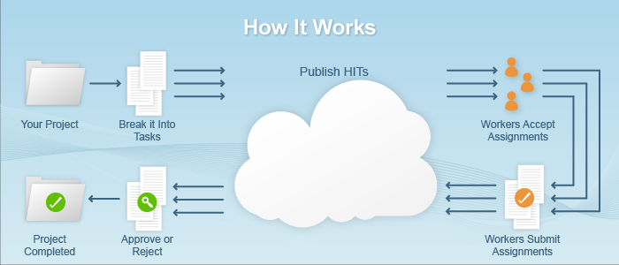
Mechanical Turk
Begin with a project
Define the goals and key components of your project. For example, your goal might be to clean your business listing database so that you have accurate information for consumers.
Break it into tasks and design your HIT
Break the project into individual tasks; e.g., if you have 1,000 listings to verify, each listing would be an individual task.
Next, design your Human Intelligence Tasks (HITs) by writing crisp and clear instructions, identifying the specific outputs/inputs desired and how much you will pay to have work completed.
Publish HITs to the marketplace
You can load millions of HITs into the marketplace. Each HIT can have multiple assignments so that different Workers can provide answers to the same set of questions and you can compare the results to form an agreed-upon answer.
https://requester.mturk.com/tour/how_it_works

Slide 25
Mechanical Turk
Workers accept assignments
If Workers need special skills to complete your tasks, you can require that they pass a Qualification test before they are allowed to work on your HITs.
You can also require other Qualifications such as the location of a Worker or that they have completed a minimum number of HITs.
Workers submit assignments for review
When a Worker completes your HIT, he or she submits an assignment for you to review.
Approve or reject assignments
When your work items have been completed, you can review the results and approve or reject them. You pay only for approved work.
Complete your project
Congratulations! Your project has been completed and your Workers have been paid.
https://requester.mturk.com/tour/how_it_works

Slide 26
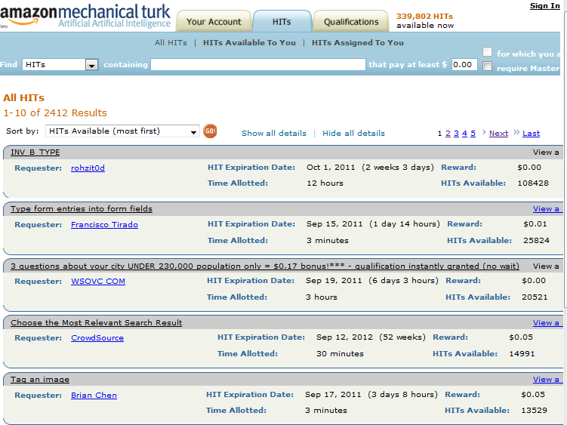
Screenshot

Slide 27
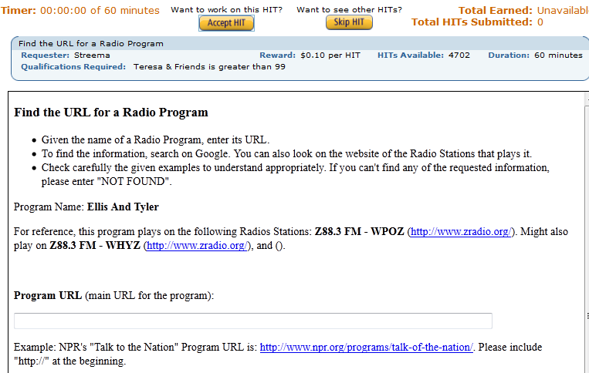

Slide 28
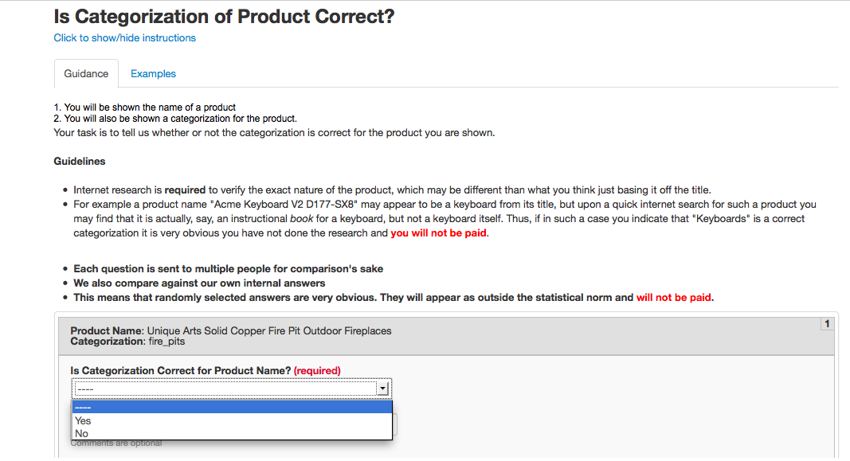

Slide 29
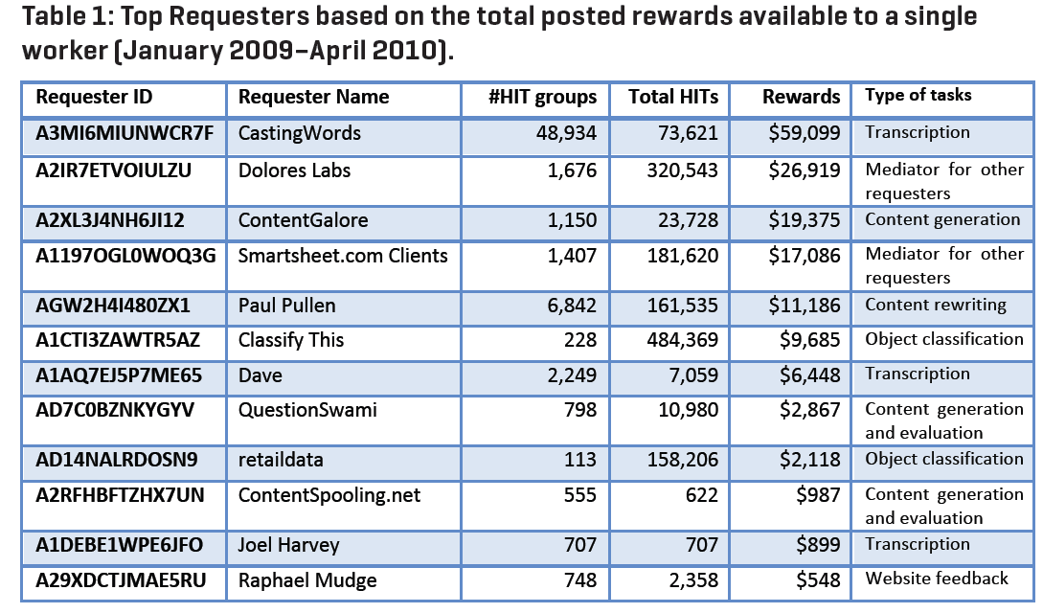
Type of Tasks in M-Turk

Slide 30
How Could We Use Crowdsourcing for IE?

Slide 31
A Real-Life Case Study

Slide 32
IE from Text
Attribute | Walmart Product | Vendor Product
Product Name | CHAMP Bluetooth Survival Solar Multi-Function Skybox with Emergency AM/FM NOAA Weather Radio (RCEP600WR) | CHAMP Bluetooth Survival Solar Multi-Function Skybox with Emergency AM/FM NOAA Weather Radio (RCEP600WR)
Product Short Description | BLTH SURVIVAL SKYBOX W WR
Product Long Description | BLTH SURVIVAL SKYBOX W WR | BLTH SURVIVAL SKYBOX W WR
Product Segment | Electronics | Electronics
Product Type | CB Radios & Scanners | Portable Radios
Color | Black
Actual Color | Black
UPC |  | 0004447611732
Unique product identifier (aka key in e-commerce industry)

Slide 33
IE from Text
Attribute | Walmart Product | Vendor Product
Product Name | GreatShield 6FT Apple MFi Licensed Lightning Sync Charge Cable for Apple iPhone 6 6 Plus 5S 5C 5 iPad 4 Air Mini - Black | GreatShield 6FT Apple MFi Licensed Lightning Sync Charge Cable for Apple iPhone 6 6 Plus 5S 5C 5 iPad 4 Air Mini - White
Product Short Description | GreatShield 6FT Apple MFi Licensed Lightning Sync Charge Cable for Apple iPhone 6 6 Plus 5S 5C 5 iPad 4 Air Mini - Black
Product Long Description | GreatShield Apple MFi Licensed Lightning Charge & Sync Cable This USB 2.0 cable connects your iPhone, iPad, or iPod with Lightning … | GreatShield Apple MFi Licensed Lightning Charge & Sync Cable This USB 2.0 cable connects your iPhone, iPad, or iPod with Lightning …
Product Segment | Electronics | Electronics
Product Type | Cable Connectors | Cable Connectors
Brand | GreatShield | GreatShield
Manufacturer Part Number | GS09055

Slide 34
Attribute Extraction from Text
Our focus: brand name extraction
Problem definition: extracting a product’s brand name from the product title (a short textual product description)
e.g. extracting “Hitachi” from “Hitachi TV 32" in black HD 368X-42”
Knowing brand names is important for
Trend analysis
Sales prediction
Inventory management
…

Slide 35
Challenges
Hard to achieve high accuracy
Require precision above 0.95 and recall improving over time
Hard to achieve high precision
Ambiguous brand names
e.g. “Apple iPad Mini 16GB – Black” and “Apple Juice by Minute Maid, 1 Gallon”
Variations and typos
Hard to achieve high recall
A lot of brand names only have a few products
e.g. “Orginnovations Inc” with only 15 product items in our dataset
Limited human resources
1 or 2 analysts/developers

Slide 36
Key Ideas of Our Solution
Use dictionary-based IE
Construct, monitor and maintain a brand name dictionary for each product department
Use dictionaries to perform IE
Achieving high precision
Monitor precision by the crowd
When precision drops below 0.95, then ask the analyst/developer to modify the dictionary to improve precision
Achieving high recall
Crowdsource the extraction of brand name for products with brand names not in the dictionary

Slide 37
Key Ideas of Our Solution (Cont.)
Don’t involve the developer/analyst as long as the accuracy requirements are satisfied
Use crowdsourcing whenever possible
Evaluate and monitor precision and recall
Improve recall

Slide 38


Architecture of Our Solution
Web
Crawls
Product Items
Brand Name Dictionaries
Result
Sample
In-house Databases
Dictionary Construction
Brand Name Extraction
Extraction Results
Online Listings
Evaluate
Precision
Tune for Precision
(Analyst/Developer)
No
No
Is recall > 0.9?
Evaluate Recall
Yes
Is precision > 0.95?
Tune for Recall
(Crowd)
Yes
Done
Populate Product Database

Slide 39
Architecture of Our Solution
Web
Crawls
Product Items
Brand Name Dictionaries
Result
Sample
In-house Databases
Dictionary Construction
Brand Name Extraction
Extraction Results
Online Listings
Evaluate
Precision
Tune for Precision
(Analyst/Developer)
No
No
Is recall > 0.9?
Evaluate Recall
Yes
Is precision > 0.95?
Tune for Recall
(Crowd)
Yes
Done
Populate Product Database

Slide 40
Dictionary Construction: Initialization
Create a brand name dictionary for each product department using:
In-house data
Product pages crawled from other retailers’ web sites
Online brand name lists
e.g. http://www.namedevelopment.com/brand-names.html

Slide 41
Dictionary Construction: Clean Up
For each entry in brand name dictionaries, discard if:
Number of product items in our in-house with this brand name is too small (e.g. < 10)
It is a very common word in our in-house product item descriptions (e.g. more than 2000 item descriptions contain this entry)

Slide 42
Dictionary Construction: Adding Variations
Add brand name variations
Using the following rules:
If brand name contains “ and ”, add the variation with “ & ” and vice versa
If brand name contains any of the following phrases, add the variations with others replaced:
“ co”, “ corp”, “ corporation”, “ ltd”, “ limited”, “ inc”, “ incorporated”
If brand name contains dot character(s), add variations with arbitrary no of dots removed
e.g. for “S. Lichtenberg & Co.” add “S Lichtenberg & Co”, “S. Lichtenberg and Co.”, etc.

Slide 43
Architecture of Our Solution
Web
Crawls
Product Items
Brand Name Dictionaries
Result
Sample
In-house Databases
Dictionary Construction
Brand Name Extraction
Extraction Results
Online Listings
Evaluate
Precision
Tune for Precision
(Analyst/Developer)
No
No
Is recall > 0.9?
Evaluate Recall
Yes
Is precision > 0.95?
Tune for Recall
(Crowd)
Yes
Done
Populate Product Database

Slide 44
Brand Name Extraction
For each newly arrived product item:
Detect the product’s department
e.g. using Chimera product classification system [DOAN’14]
Load the corresponding brand name dictionary as a prefix tree
Use prefix tree to look up the product title for brand names occurring in predefined patterns:
Brand name appearing at the beginning of the title
Example: “Nuvo Lighting 60/332 Two Light Reversible Lighting”
etc

Slide 45
Brand Name Extraction (Cont.)
Add all the dictionary entries found in the title to the candidate brand set
For each pair of entries in the candidate brand set:
If one is a substring of the other, discard the shorter one
Example: discard “Tommee” if “Tommee Tippee” is also in the result set
Report an extracted brand name for the current product item if:
There is only one candidate brand name in the candidate brand set
This candidate brand name is not in the current department’s brand name blacklist (created by analyst(s))

Slide 46
Architecture of Our Solution
Web
Crawls
Product Items
Brand Name Dictionaries
Result
Sample
In-house Databases
Dictionary Construction
Brand Name Extraction
Extraction Results
Online Listings
Evaluate
Precision
Tune for Precision
(Analyst/Developer)
No
No
Is recall > 0.9?
Evaluate Recall
Yes
Is precision > 0.95?
Tune for Recall
(Crowd)
Yes
Done
Populate Product Database

Slide 47
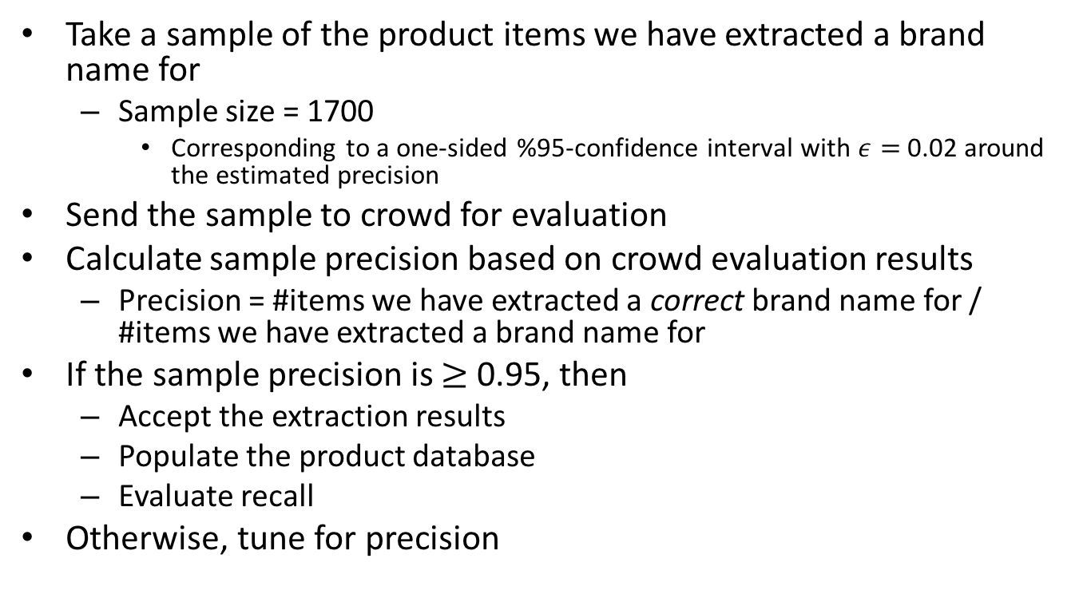
Evaluate Extraction Precision
Take a sample of the product items we have extracted a brand name for
Sample size = 1700
Corresponding to a one-sided %95-confidence interval with $ε=$ 0.02 around the estimated precision
Send the sample to crowd for evaluation
Calculate sample precision based on crowd evaluation results
Precision = #items we have extracted a correct brand name for / #items we have extracted a brand name for
If the sample precision is $≥$ 0.95, then
Accept the extraction results
Populate the product database
Evaluate recall
Otherwise, tune for precision

Slide 48
Tune for Precision
Take a sample of the product items we have extracted a brand name for
e.g. 100 product items
Ask the analyst to go through them and add non-brands or ambiguous brand names to the blacklist of the corresponding product department
Go to brand extraction step

Slide 49
Architecture of Our Solution
Web
Crawls
Product Items
Brand Name Dictionaries
Result
Sample
In-house Databases
Dictionary Construction
Brand Name Extraction
Extraction Results
Online Listings
Evaluate
Precision
Tune for Precision
(Analyst/Developer)
No
No
Is recall > 0.9?
Evaluate Recall
Yes
Is precision > 0.95?
Tune for Recall
(Crowd)
Yes
Done
Populate Product Database

Slide 50
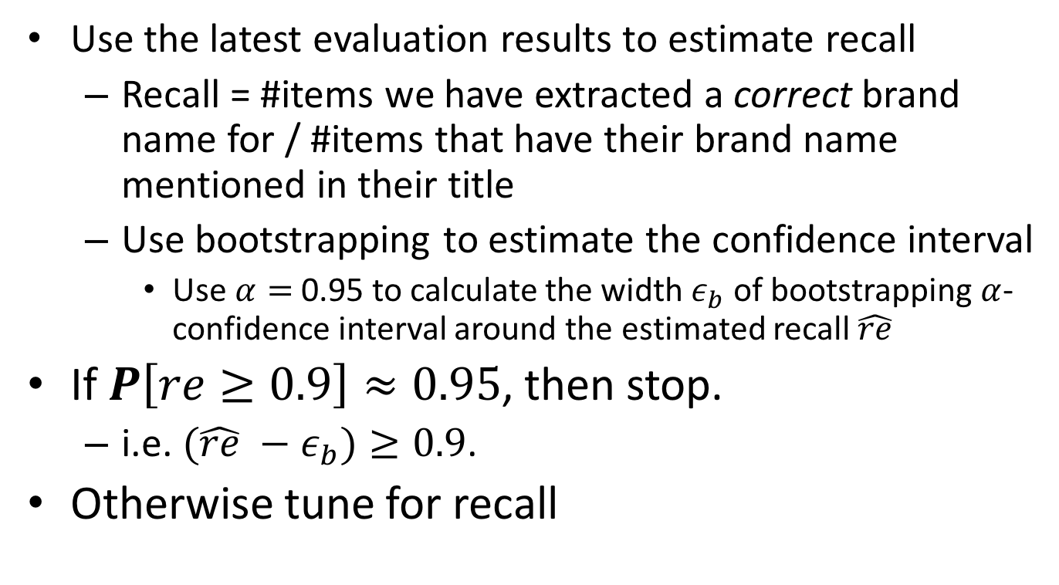
Estimate Extraction Recall
Use the latest evaluation results to estimate recall
Recall = #items we have extracted a correct brand name for / #items that have their brand name mentioned in their title
Use bootstrapping to estimate the confidence interval
Use $α=$ 0.95 to calculate the width $ε_{b}$ of bootstrapping $α$-confidence interval around the estimated recall $\hat{re}$
If $P\left[re≥0.9\right]≈0.95$, then stop.
i.e. $(\hat{re} −ε_{b})≥0.9$.
Otherwise tune for recall

Slide 51
Tune for Recall
Take a sample of the product items the brand names of which do not appear in the brand dictionary
e.g. sample size = 1000
Send the sample to the crowd for manual brand extraction
Send each item to 2 workers
If extracted brands are the same, then add it to the brand name dictionary
Otherwise
Send the item to a 3rd worker
If 2 out of 3 agree on a brand name, then add it to the brand name dictionary
Otherwise ignore them
Go to brand extraction step

Slide 52
Experiments
Home products department
142K product items for which a brand name has not been extracted before
Constructing brand name dictionary
~37K brand names
Tuning the system
Perform 7 rounds of precision evaluation (crowd) and tuning (developer)
Perform 1 round of recall evaluation and tuning (crowd)

Slide 53
Results
Accuracy:
Precision = 0.95 (27917 / 29276)
Recall = 0.93 (27917 / 30000)
Precision evaluation (Samasource*)
Cost = ~$2500 (~12K items, $210 per 1000 items)
Duration = ~34 hours (2 hr 50 min per 1000 items)
Recall tuning (Amazon Mechanical Turk**)
Cost = $154 (for 1000 items)
Duration = 1 hour 35 minutes (for 1000 items)
* http://www.samasource.org/
** https://www.mturk.com/

Slide 54
Conclusion
Our proposed solution can extract brand names from product titles with high accuracy and relatively low cost.
Using this solution is effective for domains that:
Have relatively small number of ambiguous values
e.g. appearance in an English language dictionary as an indication of ambiguity
~2000 brand names in home department dictionary appear in an English language dictionary.
Don’t grow too fast
The rate of values added to the domain comparable to the rate our solution can find new brand names within budget limits
e.g. ~250 brand names (found via crowdsourcing) in ~2 hours spending $154

